Slide 1
Module #12:
Inductive Proofs
26年 11月 8日
©2001-2004 Michael P. Frank, revised by S. Kang

Slide 2
Outline of an Inductive Proof
Let us say we want to prove ∀n P(n)…
  Do the base case (or basis step): Prove P(0).
  Do the inductive step: Prove ∀n P(n)→P(n+1).
    E.g. you could use a direct proof, as follows:
    Let n∈N, assume P(n). (inductive hypothesis)
    Now, under this assumption, prove P(n+1).
  The inductive inference rule then gives us
  ∀n P(n).
26年 11月 8日
©2001-2004 Michael P. Frank, revised by S. Kang

Slide 3
§3.3: Mathematical Induction
A powerful, rigorous technique for proving that a predicate P(n) is true for every natural number n, no matter how large.
Essentially a “domino effect” principle.
Based on a predicate-logic inference rule:
P(0)
∀n≥0 (P(n)→P(n+1))
∴∀n≥0 P(n)
“The First Principle
of Mathematical
Induction”
26年 11月 8日
©2001-2004 Michael P. Frank, revised by S. Kang

Slide 4
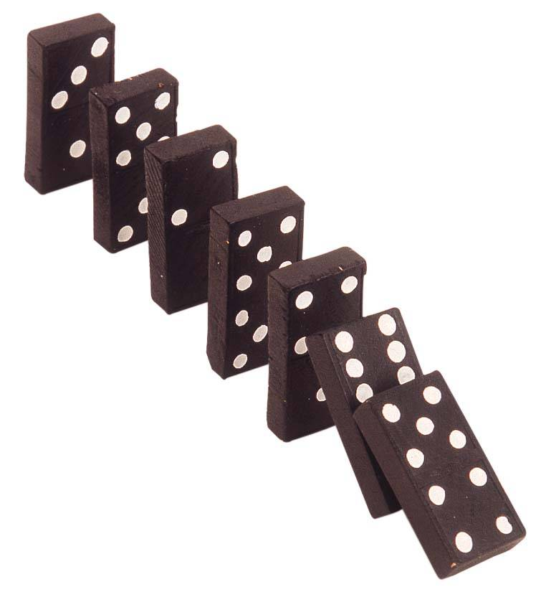
The “Domino Effect”
Premise #1: Domino #0 falls.
Premise #2: For every n∈N,
if domino #n falls, then so does domino #n+1.
Conclusion: All of
the dominoes fall
down!
Note:
this works
even if there
are infinitely
many dominoes!
26年 11月 8日
©2001-2004 Michael P. Frank, revised by S. Kang

Slide 5
Validity of Induction
Proof that ∀k≥0 P(k) is a valid consequent:
Given any k≥0, the 2nd antecedent
∀n≥0 (P(n)→P(n+1)) trivially implies that
∀n≥0 (n<k)→(P(n)→P(n+1)), i.e., that (P(0)→P(1)) ∧ (P(1)→P(2)) ∧ … ∧ (P(k−1)→P(k)). Repeatedly applying the hypothetical syllogism rule to adjacent implications in this list k−1 times then gives us P(0)→P(k); which together with P(0) (antecedent #1) and modus ponens gives us P(k). Thus ∀k≥0 P(k). ■
26年 11月 8日
©2001-2004 Michael P. Frank, revised by S. Kang

Slide 6
The Well-Ordering Property
Another way to prove the validity of the inductive inference rule is by using the well-ordering property, which says that:
  Every non-empty set of non-negative integers has a minimum (smallest) element.
  ∀ ∅⊂S⊆N : ∃m∈S : ∀n∈S : m≤n
This implies that {n|¬P(n)} (if non-empty) has a min. element m>0, but then the assumption that P(m−1)→P((m−1)+1) would be contradicted.
26年 11月 8日
©2001-2004 Michael P. Frank, revised by S. Kang

Slide 7
Generalizing Induction
Mathematical Induction can also be used to prove ∀n≥c P(n) for a given constant c∈Z, where maybe c≠0.
  In this circumstance, the base case is to prove P(c) rather than P(0), and the inductive step is to prove ∀n≥c (P(n)→P(n+1)).
Induction can also be used to prove
∀n≥c P(a_{n}) for any arbitrary series {a_{n}}.
26年 11月 8日
©2001-2004 Michael P. Frank, revised by S. Kang
Notes:
Discrete Mathematics and its Applications
(c)2001-2002, Michael P. Frank

Slide 8
Second Principle of Induction
A.k.a. “Strong Induction”
Characterized by another inference rule:
P(0)
∀n≥0: (∀0≤k≤n P(k)) → P(n+1)
∴∀n≥0: P(n)
The only difference between this and the 1st principle is that:
  the inductive step here makes use of the stronger hypothesis that P(k) is true for all smaller numbers k<n+1, not just for k=n.
P is true in all previous cases
26年 11月 8日
©2001-2004 Michael P. Frank, revised by S. Kang

Slide 9
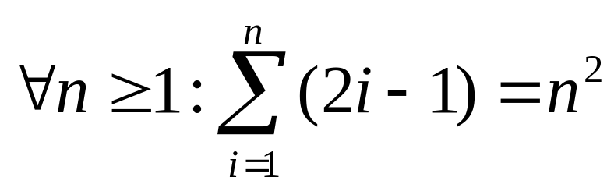
Induction Example (1st princ.)
Prove that the sum of the first n odd positive integers is n². That is, prove:
Proof by induction.
  Base case: Let n=1. The sum of the first 1 odd positive integer is 1 which equals 1².
  (Cont…)
P(n)
26年 11月 8日
©2001-2004 Michael P. Frank, revised by S. Kang

Slide 10
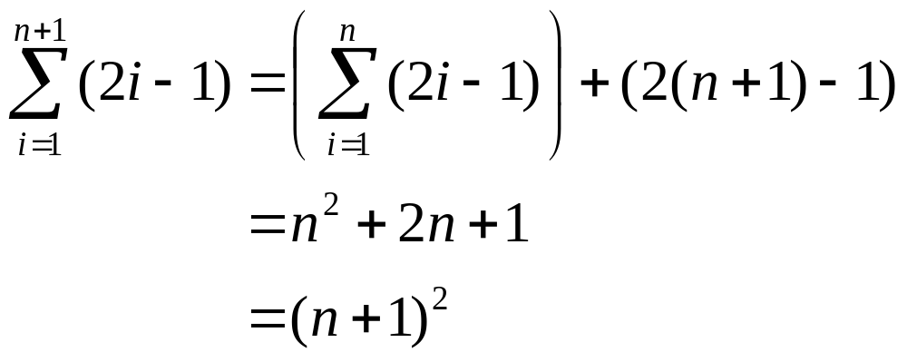
Example cont.
Inductive step: Prove ∀n≥1: P(n)→P(n+1).
  Let n≥1, assume P(n), and prove P(n+1).
By inductive
hypothesis P(n)
26年 11月 8日
©2001-2004 Michael P. Frank, revised by S. Kang

Slide 11
Another Induction Example
Prove that ∀n>0, n<2^{n}. Let P(n)=(n<2^{n})
  Base case: P(1)=(1<2¹)=(1<2)=T.
  Inductive step: For n>0, prove P(n)→P(n+1).
    Assuming n<2^{n}, prove n+1 < 2^{n+1}.
    Note n + 1 < 2^{n} + 1 (by inductive hypothesis)
    < 2^{n} + 2^{n} (because 1<2=2⋅2⁰≤2⋅2^{n-1}= 2^{n})
    = 2^{n+1}
    So n + 1 < 2^{n+1}, and we’re done.
26年 11月 8日
©2001-2004 Michael P. Frank, revised by S. Kang

Slide 12
Example of Second Principle
Show that every n>1 can be written as a product
∏ p_{i} = p₁p₂…p_{s} of some series of s prime numbers.
  Let P(n)=“n has that property”
Base case: n=2, let s=1, p₁=2.
Inductive step: Let n≥2. Assume ∀2≤k≤n: P(k).
Consider n+1. If it’s prime, let s=1, p₁=n+1.
Else n+1=ab, where 1<a≤n and 1<b≤n.
Then a=p₁p₂…p_{t} and b=q₁q₂…q_{u}. Then we have that n+1 = p₁p₂…p_{t} q₁q₂…q_{u}, a product of s=t+u primes.
26年 11月 8日
©2001-2004 Michael P. Frank, revised by S. Kang

Slide 13
Another 2nd Principle Example
Prove that every amount of postage of ￦12 or more can be formed using just ￦4 and ￦ 5 stamps. P(n)=“n can be…”
Base case: 12=3(4), 13=2(4)+1(5), 14=1(4)+2(5), 15=3(5), so ∀12≤n≤15, P(n).
Inductive step: Let n≥15, assume
∀12≤k≤n P(k). Note 12≤n−3≤n, so P(n−3), so add a ￦4 stamp to get postage for n+1.
26年 11月 8日
©2001-2004 Michael P. Frank, revised by S. Kang

Slide 14
The Method of Infinite Descent
A way to prove that P(n) is false for all n∈N.
Sort of a converse to the principle of induction.
Prove first that ∀P(n): ∃k<n: P(k).
  Basically, “For every P there is a smaller P.”
But by the well-ordering property of N, we know
that ∃P(m) → ∃P(n): ∀P(k): n≤k.
  Basically, “If there is a P, there is a smallest P.”
Note that these are contradictory unless ¬∃P(m),
  that is, ∀m∈N: ¬P(m). There is no P.
26年 11月 8日
©2001-2004 Michael P. Frank, revised by S. Kang

Slide 15
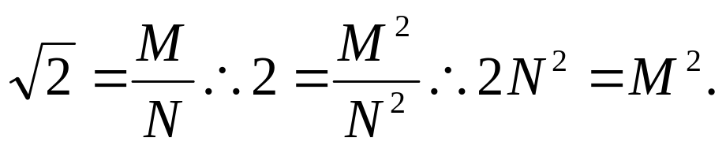
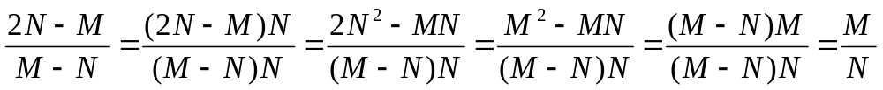
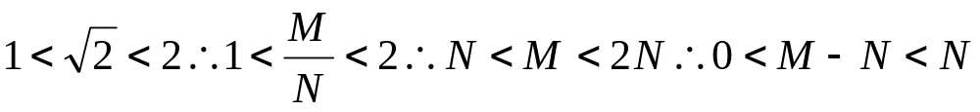
Infinite Descent Example
Theorem: 2^{1/2} is irrational.
Proof: Suppose 2^{1/2} is rational, then ∃m,n∈Z⁺: 2^{1/2}=m/n. Let M,N be the m,n with the least n.
So ∃k<N,j: 2^{1/2} = j/k (let j=2N−M, k=M−N). ■
26年 11月 8日
©2001-2004 Michael P. Frank, revised by S. Kang

